Slide 1
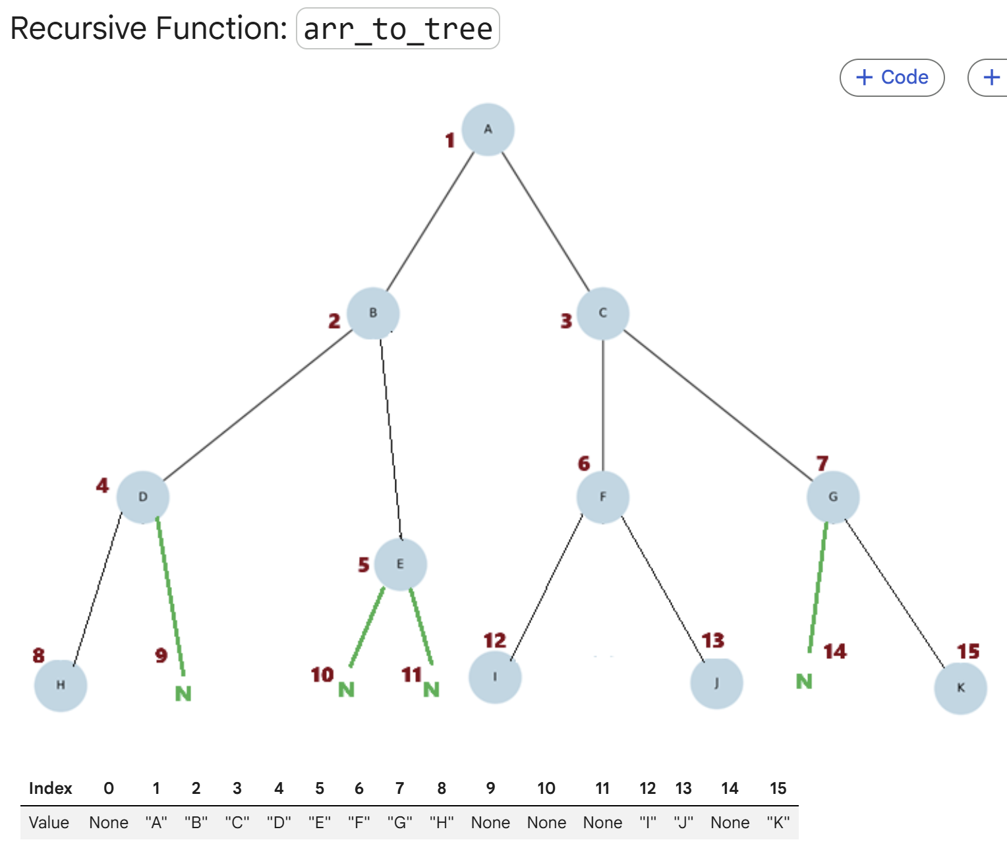
Binary Tree Implementation in Java
Array representation, array-to-tree conversion, traversal, level, height, and size
CSE220 | Binary Tree Java Lecture

Slide 2
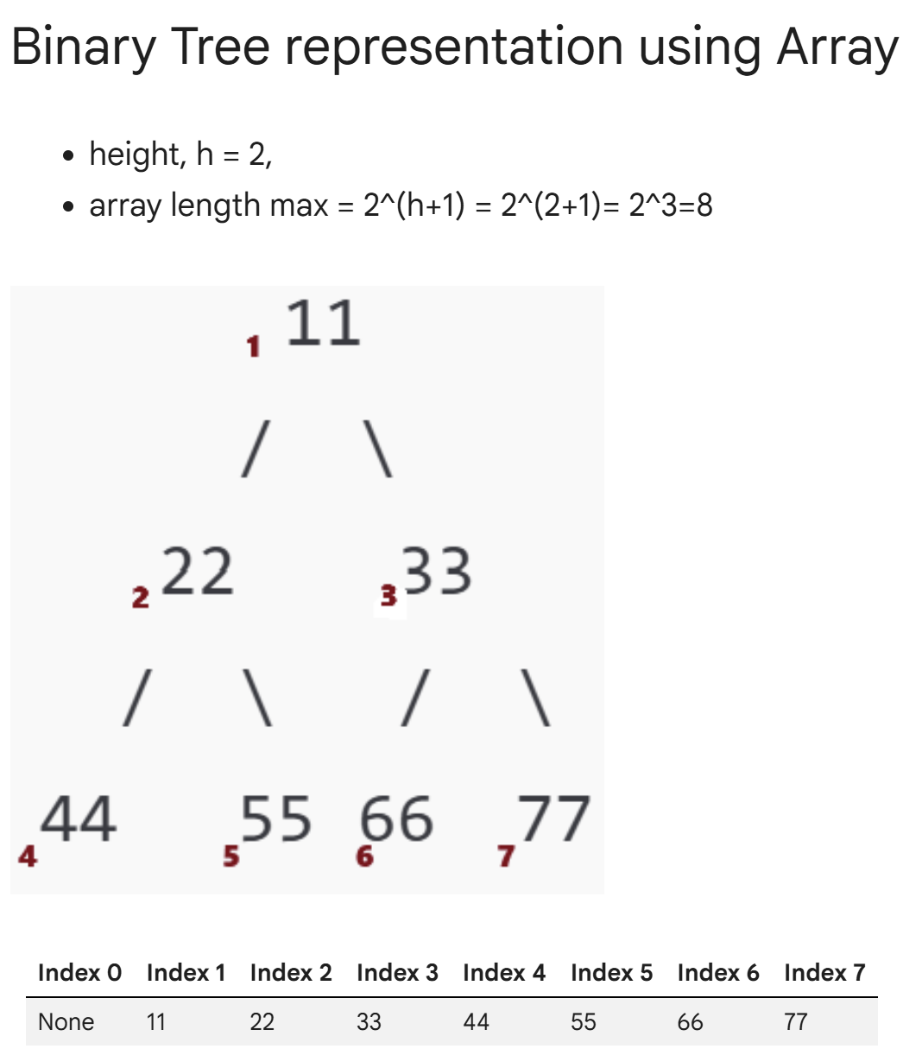
Binary Tree Representation Using Array
Key rules:
• Root is stored at index 1. Index 0 is unused.
• For node at index i: left child = 2i, right child = 2i + 1.
• For height h, maximum array length = 2^(h+1).
class Tree {
Object[] tree;
public Tree(Object root, int length) {
// 1-based indexing: index 0 unused
tree = new Object[length];
tree[1] = root;
}
public void setChild(int parentIndex, String side,
Object child) {
int childIndex;
if (side.equals("left")) {
childIndex = parentIndex * 2;
} else {
childIndex = parentIndex * 2 + 1;
}
tree[childIndex] = child;
}
}

Slide 3
Array Representation: Driver Code Example
# Driver Code
tree = Tree(root=11, length=8)
# Length is 8 to accommodate up to 7 nodes
"""
11
/ \
22 33
/ \ / \
44 55 66 77
"""
# Set children for each node
tree.set_child(parent_index=1, side='left', child_val=22)
tree.set_child(parent_index=1, side='right', child_val=33)
tree.set_child(parent_index=2, side='left', child_val=44)
tree.set_child(parent_index=2, side='right', child_val=55)
tree.set_child(parent_index=3, side='left', child_val=66)
tree.set_child(parent_index=3, side='right', child_val=77)
# Print the tree structure with indices
tree.print_tree_array()
class Tree {
Object[] tree;
public Tree(Object root, int length) {
// 1-based indexing: index 0 unused
tree = new Object[length];
tree[1] = root;
}
public void setChild(int parentIndex,
String side,
Object child) {
int childIndex;
if (side.equals("left")) {
childIndex = parentIndex * 2;
} else {
childIndex = parentIndex * 2 + 1;
}
tree[childIndex] = child;
}
}

Slide 4
Printing the Array Representation
The array stores tree nodes level by level.
Null or empty positions can be printed as "-" to show missing children clearly.
public void printTreeArray() {
for (int i = 0; i < tree.length; i++) {
if (tree[i] != null) {
System.out.print(tree[i] + " ");
} else {
System.out.print("- ");
}
}
System.out.println();
}
// Output for the example:
// - 11 22 33 44 55 66 77

Slide 5
class TNode {
String val;
TNode left, right;
TNode(String val) {
this.val = val;
}
}
Recursive Function: arrToTree()
Purpose: convert the array representation into linked nodes.
Each recursive call creates one node and then builds its left and right subtrees.
public static TNode arrToTree(String[] arr, int i) {
# Base Case: Check if index is out of bounds or
the current element is None
if (i >= arr.length || arr[i] == null) {
return null;
}
# Recursive Case:
# 1. Create a node for the current index
TNode root = new TNode(arr[i]);
# 2. Set the left child by recursively calling for index 2 * i
root.left = arrToTree(arr, 2 * i);
# 3. Set the right child by recursively calling for index 2 * i + 1
root.right = arrToTree(arr, 2 * i + 1);
return root;
}
CSE220 | Binary Tree

Slide 6
Binary Tree Traversal: Preorder, Inorder, Postorder
Traversal means visiting all nodes in a specific order. The position of the root determines the traversal type.
public static void printPreOrder(TNode root) {
if (root == null) return;
System.out.print(root.val + " "); // Root
printPreOrder(root.left); // Left
printPreOrder(root.right); // Right
}
public static void printInOrder(TNode root) {
if (root == null) return;
printInOrder(root.left); // Left
System.out.print(root.val + " "); // Root
printInOrder(root.right); // Right
}
public static void printPostOrder(TNode root) {
if (root == null) return;
printPostOrder(root.left); // Left
printPostOrder(root.right); // Right
System.out.print(root.val + " "); // Root
}
CSE220 | Binary Tree

Slide 7
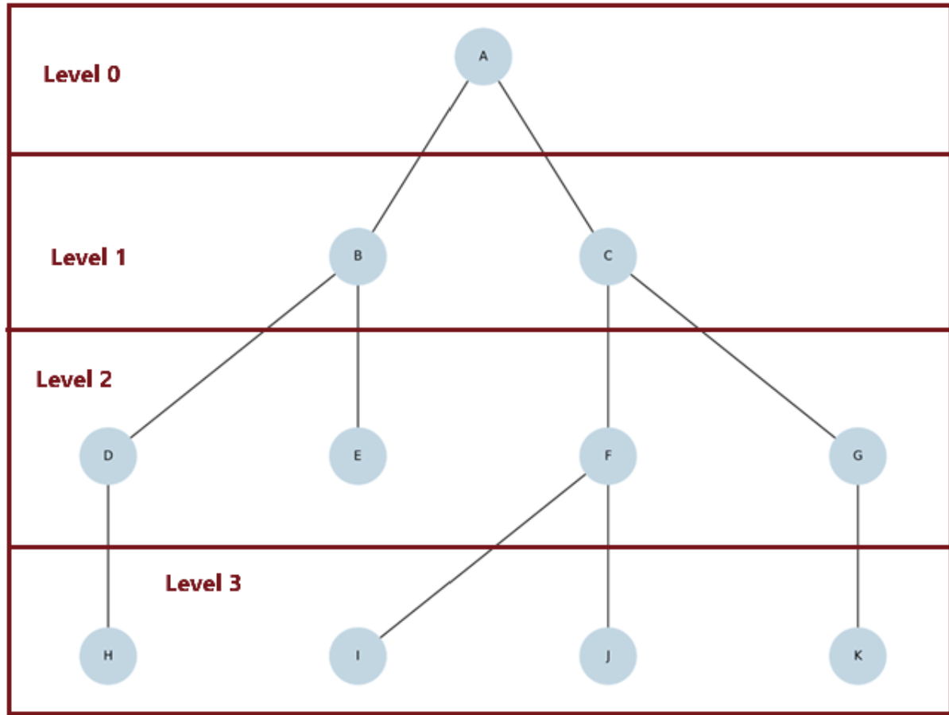
Get Level of a Node
Level/depth = number of edges from the root to the node. Start with level 0 at the root and increase by 1 in each recursive call.
public static int getLevel(TNode root, String value,
int level) {
if (root == null) {
return -1;
}
if (root.val.equals(value)) {
return level;
}
int leftLevel = getLevel(root.left, value,
level + 1);
int rightLevel = getLevel(root.right, value,
level + 1);
return Math.max(leftLevel, rightLevel);
}
CSE220 | Binary Tree

Slide 8
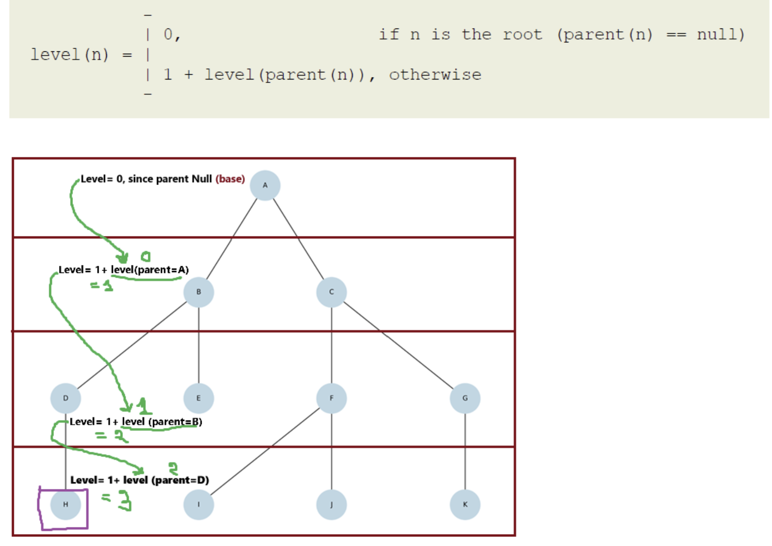
Finding the Node Before Computing Level
First search the node by value. If found, compute the level by moving through parent pointers.
public static TPNode findNode(TPNode root,
String target) {
if (root == null) return null;
if (root.val.equals(target)) return root;
TPNode left = findNode(root.left, target);
if (left != null) return left;
return findNode(root.right, target);
}
// Use together:
// TPNode node = findNode(root, "H");
// int level = getLevelWithParent(node);
CSE220 | Binary Tree

Slide 9
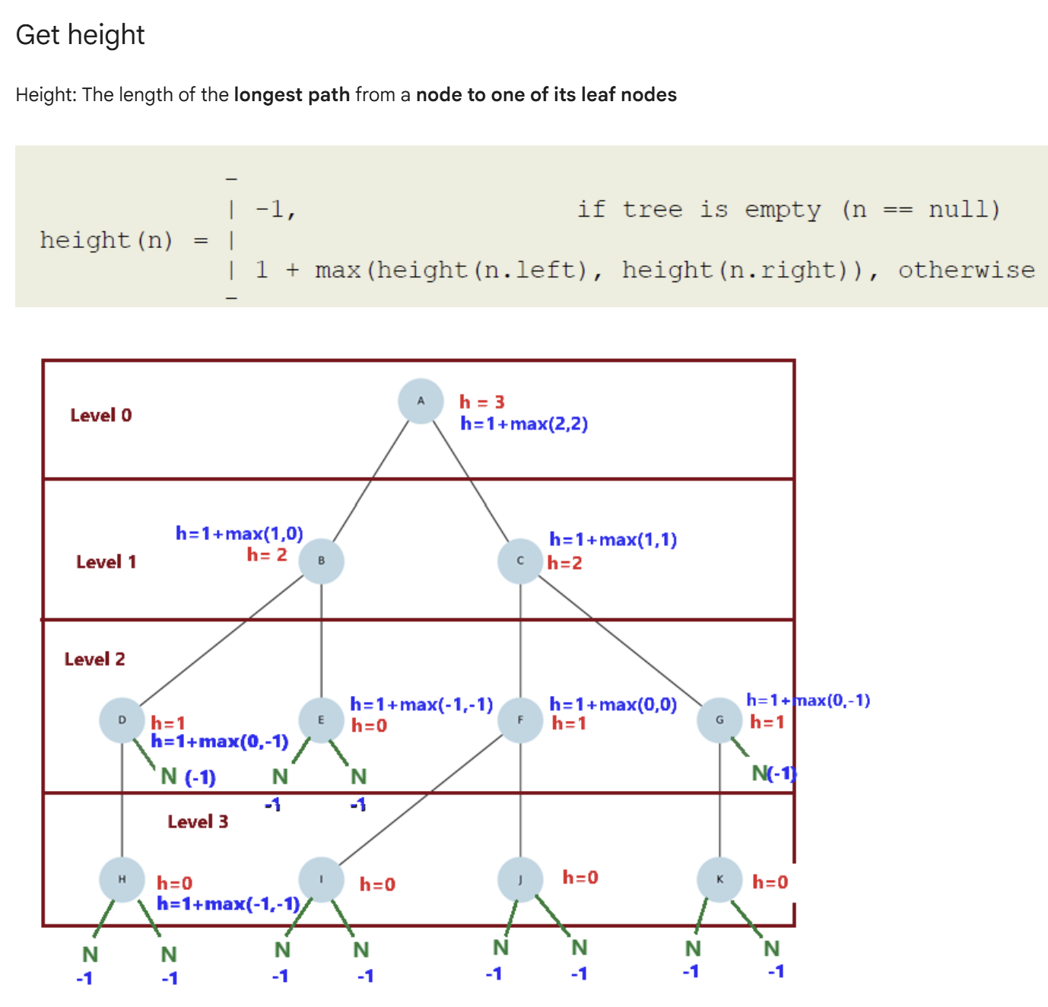
Get Height of a Node
Height = length of the longest path from a node to one of its leaf nodes.
Empty subtree height is -1, so a leaf node has height 0.
public static int getHeight(TNode node) {
if (node == null) {
return -1;
}
int leftHeight = getHeight(node.left);
int rightHeight = getHeight(node.right);
return 1 + Math.max(leftHeight,
rightHeight);
}
// Example:
// Height of A = 3
// Height of B = 2
// Height of F = 1
// Height of leaf = 0
CSE220 | Binary Tree

Slide 10
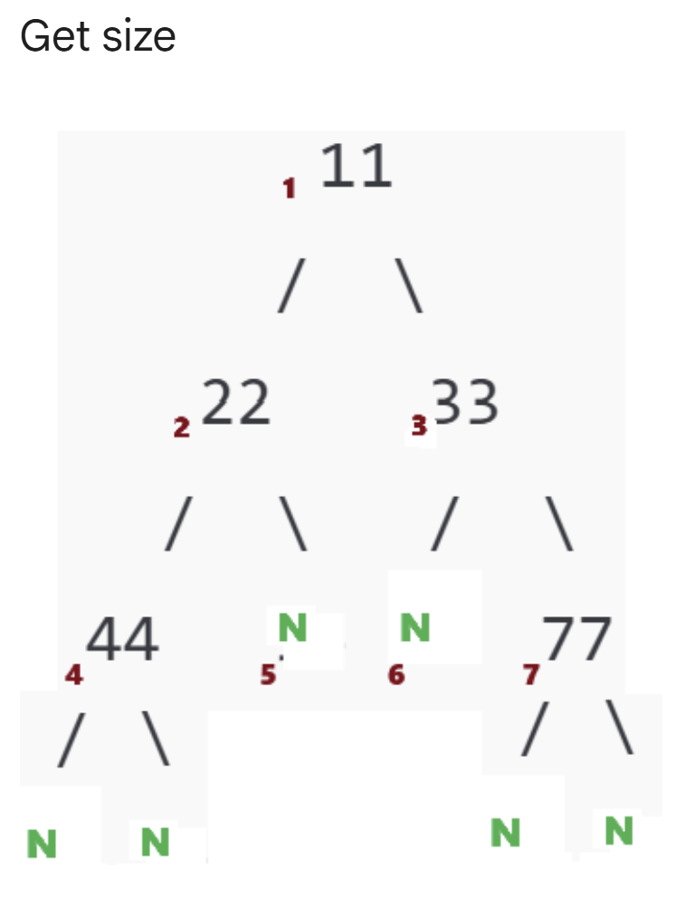
Get Size of a Binary Tree
Size = total number of actual nodes in the tree.
Null links are not counted as nodes.
public static int getSize(TNode node) {
if (node == null) {
return 0;
}
return 1
+ getSize(node.left)
+ getSize(node.right);
}
// Meaning:
// current node + left subtree size
// + right subtree size
CSE220 | Binary Tree

